Slide 1
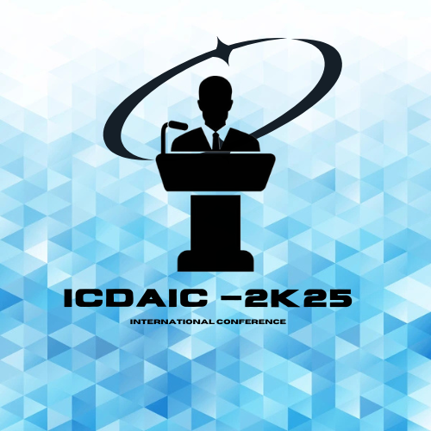


1ST INTERNATIONAL CONFERENCE ON DATA ANALYTICS AND INTELLIGENCE COMPUTING– (ICDAIC-25)
9th APRIL 2025
THYROID NODULES DETECTION USING
DEEP LEARNING
Presented by,
Name: Mr. Rajesh.S, S. Abinaya, M. Karthika, V. Swetha
Affiliation: Paavai Engineering College

Slide 2
OUTLINE
Abstract
Aim Of The Project
Existing System
Proposed System
Technology used
Modules & Advantages
Block Diagram
Results
Conclusion &Future enhancement
References

Slide 3
ABSTRACT :
Thyroid nodules are abnormal growths in the thyroid gland that can be benign or malignant.
Early detection and classification are crucial for effective treatment.
This project utilizes Deep Learning, specifically Convolutional Neural Networks (CNN) with an extended VGG algorithm, to improve accuracy in thyroid nodule detection.
The model processes ultrasound images to differentiate between benign and malignant nodules, reducing dependency on manual diagnosis.

Slide 4
AIM OF THE PROJECT:
To develop an automated, accurate, and efficient deep-learning model for thyroid nodule detection and classification.
To enhance diagnostic accuracy using CNN and an improved VGG algorithm.
To reduce false positives and negatives in thyroid nodule detection.

Slide 5
EXISTING SYSTEM :
Traditional diagnosis relies on ultrasound imaging and manual expert evaluation.
Machine learning models exist but often suffer from low accuracy and high false-positive rates.
Lack of a standardized deep-learning approach for robust classification.

Slide 6
PROPOSED SYSTEM:
Develops a deep-learning model using CNN and VGG extension to improve accuracy.
Automates feature extraction from ultrasound images to differentiate nodules.
Reduces human intervention while enhancing early and precise diagnosis.
Utilizes advanced image processing techniques for better detection performance.

Slide 7
TECHNOLOGY USED:
Deep Learning Framework: TensorFlow/Keras, PyTorch
Algorithms: CNN, VGG Extension (VGG-16/VGG-19 modifications)
Programming Language: Python
Image Processing: OpenCV, PIL
Dataset: DDTI, Stanford Thyroid Ultrasound Cine Clips, and Publicly available thyroid ultrasound image datasets

Slide 8
MODULES :
Thyroid Ultrasound Image
Raw ultrasound image of the thyroid gland.
Contains structural info and potential nodules.
Preprocessing
Enhances image quality for analysis.
Includes noise reduction, contrast/brightness adjustments, artifact removal.
Image Augmentation
Increases dataset size and diversity.
Techniques: rotation, flip, zoom, translation, added noise.
Improves generalization and reduces overfitting.

Slide 9
CNN Feature Extraction
Uses CNN to extract key image features.
Learns from basic textures to complex patterns.
Automates feature learning for image analysis.
VGG Extension Deeper Feature Refinement
Refines features using a pre-trained or extended VGG model.
Adds layers or fine-tunes for thyroid-specific data.
Captures subtle and detailed image patterns.
Feature Fusion
Combines multiple features (textures, edges, shapes).
Provides a more complete image understanding.
Boosts accuracy in identifying nodules.

Slide 10
Classification, Localization, Output
Decides if a nodule is present.
Assists in clinical decision-making.
Pinpoints nodule location in the image.
Displays detected nodules and their locations.
Shown via bounding boxes or segmentation masks.
Advantages
High Accuracy: Deep learning improves detection
performance.
Scalable: Can analyze large datasets efficiently.
Non-Invasive: Works directly on existing ultrasound images.
Assistive Tool: Supports radiologists with confidence scores
and visual cues.

Slide 11
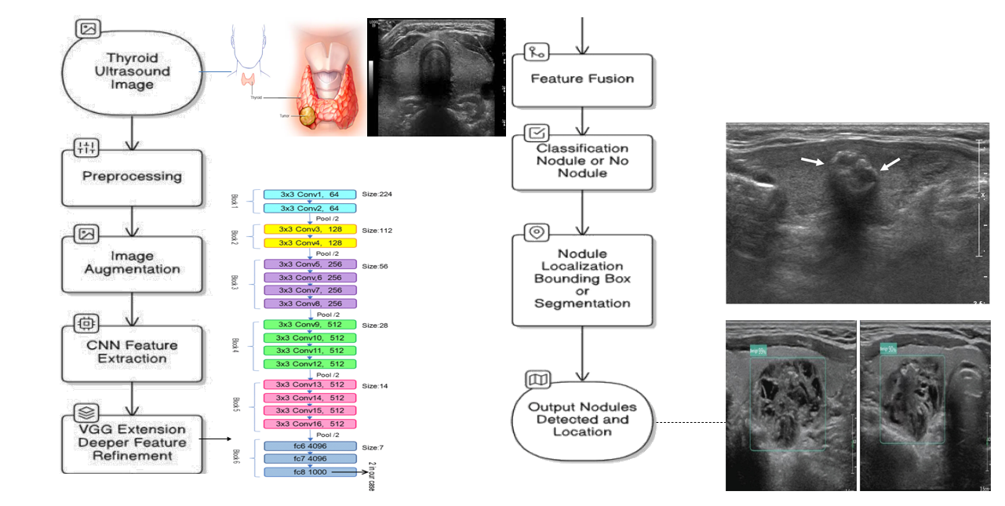
BLOCK DIAGRAM

Slide 12
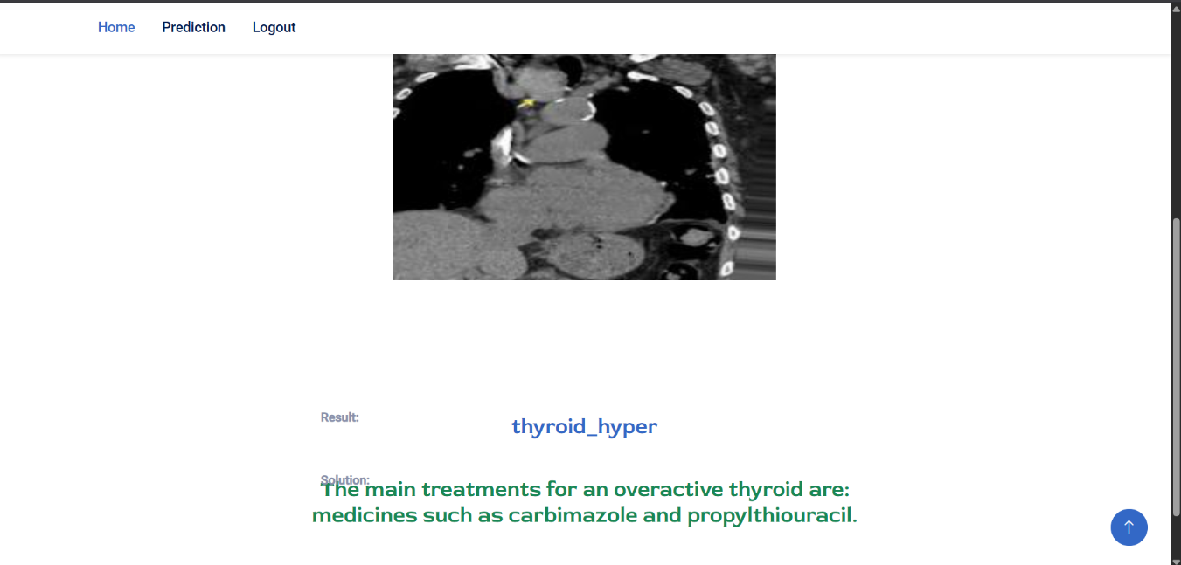
RESULTS :
Outcome
Reliable nodule detection with localization.
Confidence scoring aids clinical decisions.
Supports early diagnosis and reduces unnecessary biopsies.

Slide 13
CONCLUSION & FUTURE ENHANCEMENT:
Deep learning, especially CNN + VGG, is effective in thyroid nodule analysis. Combining preprocessing, augmentation, and feature fusion improves performance. This approach supports early, accurate diagnosis.
Real-Time Detection: Integrate into live ultrasound systems.
Multi-Class Classification: Distinguish between benign and malignant nodules.
Explainable AI: Visual explanations to improve clinical trust.
Larger Datasets: Train with more diverse patient data.
Cloud Integration: Remote access and collaboration tools.

Slide 14
REFERENCE
Y. Hang, ‘‘Thyroid nodule classification in ultrasound images by fusion of conventional features and res-GAN deep features,’’ J.Healthcare Eng.,vol. 2021, pp. 1–7, Jul. 2021.
A. Saini, K. Guleria, and S. Sharma, ‘‘Machine learning approaches for early identification of thyroid disease,’’ in Proc. World Conf.Commun. Comput. (WCONF), Jul. 2023, pp. 1–6.
T. Khan, ‘‘Application of two-class neural network-based classification model to predict the onset of thyroid disease,’’ in Proc. 11th Int. Conf.Cloud Comput., Data Sci. Eng., Jan. 2021, pp. 114–118.
R. Srivastava and P. Kumar, ‘‘Optimizing CNN based model for thyroid nodule classification using data augmentation, segmentation and boundary detection techniques,’’ Multimedia Tools Appl., vol. 82, no. 26, pp. 41037–41072, Nov. 2023.
Y. Wang and J. Gan, ‘‘Benign and malignant classification of thyroid nodules based on ConvNeXt,’’ in Proc. 3rd Int. Conf. Control, Robot. Intell. Syst., Aug. 2022, pp. 56–60.

Slide 15
Thank You

